Slide 1


The Sparks Foundation
Graduate Rotational Internship Program
Data Science & Business Analytics Tasks1.
Author: Priyanka Biswas

Slide 2
Business Problem:
Prediction using Supervised ML. Predict the percentage of an student based on the no. of study hours.
Objective:
This is a simple linear regression task as it involves just 2 variables. predicted score if a student studies for 9.25 hrs/ day?

Slide 3
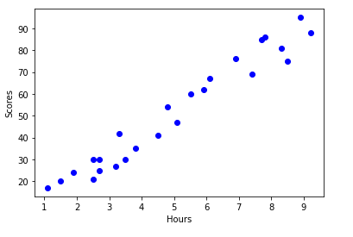
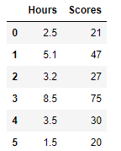
Data set details
The dataset contains total 25 records of Hours and Scores. Hours column contains hourly records of Scores.

Slide 4
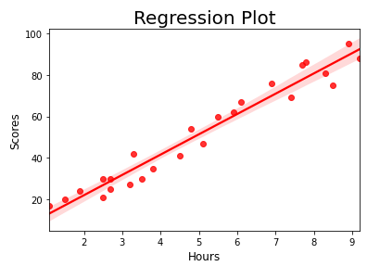
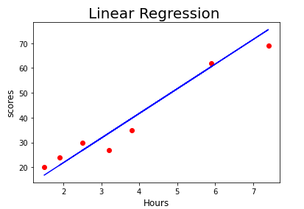
EDA:
Prediction using Supervised ML. Predict the percentage of an student based on the no. of study hours.

Slide 5
Model Building
Linear regression is a linear model, a model that assumes a linear relationship between the input variables (Hours) and the single output variable (Scores). More specifically, that Scores can be calculated from a linear combination of the input variables (Hours).
According to the regression model if a student studies for 9.25 hours a day likely to score 93.89 marks.
STATS MODELS allows users to fit statistical models using R-style formulas. Internally, stats models uses the patsy package to convert formulas and data to the matrices that are used in model fitting. The formula framework is quite powerful; this tutorial only scratches the surface.
According to the statsmodel.api if a student studies for 9.25 hours a day likely to score 92.91 marks.

Slide 6
Thank You

